Slide 1

3. Quality Control of scRNAseq
Jose Alejandro Romero Herrera
Data Scientist

Slide 2
Agenda. Postprocessing
Quality control
Dimensionality reduction and Visualization
R language-Seurat
Clustering
Batch correction
DEG analysis
GREAT, PANTHER, GOrilla, DAVID
GO-term and pathway analysis
Diffusion maps/Slingshot
Pseudotime
Notes:
Glossary of single cell terms: https://nbisweden.github.io/single-cell-pbl/glossary_of_terms_single_cell.html
R language: https://www.r-project.org/ https://rstudio.com/
Seurat: https://satijalab.org/seurat/
GREAT: http://great.stanford.edu/public/html/
PANTHER: http://www.pantherdb.org/
GOrilla: http://cbl-gorilla.cs.technion.ac.il/
DAVID: https://david.ncifcrf.gov/
Diffusion maps: https://www.sciencedirect.com/science/article/pii/S1063520306000546
Slingshot: https://bmcgenomics.biomedcentral.com/articles/10.1186/s12864-018-4772-0

Slide 3
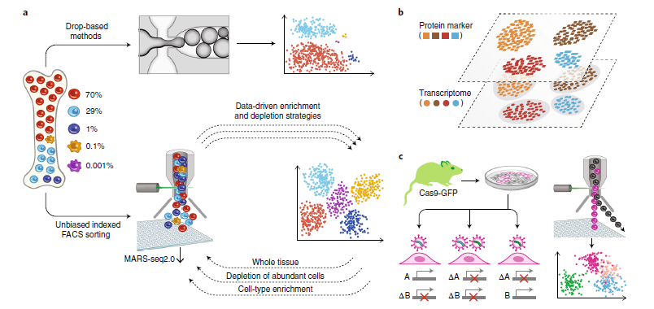
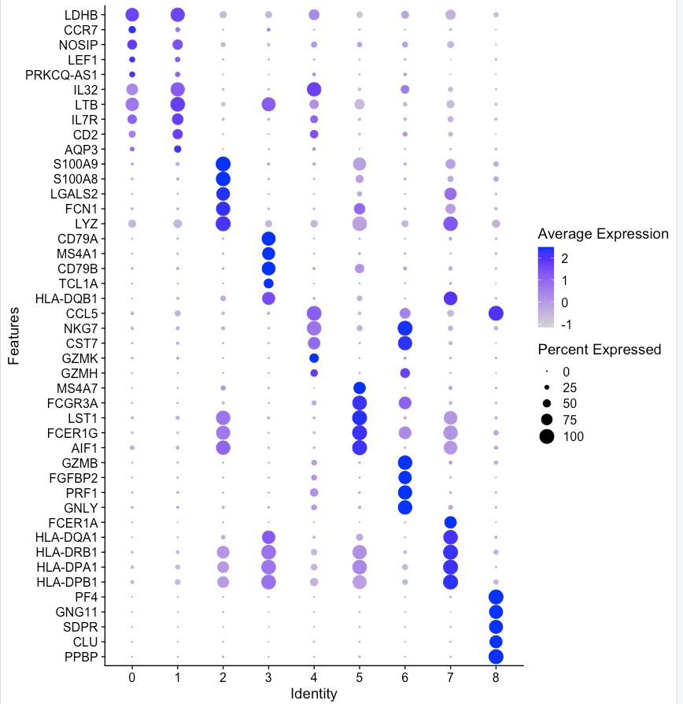
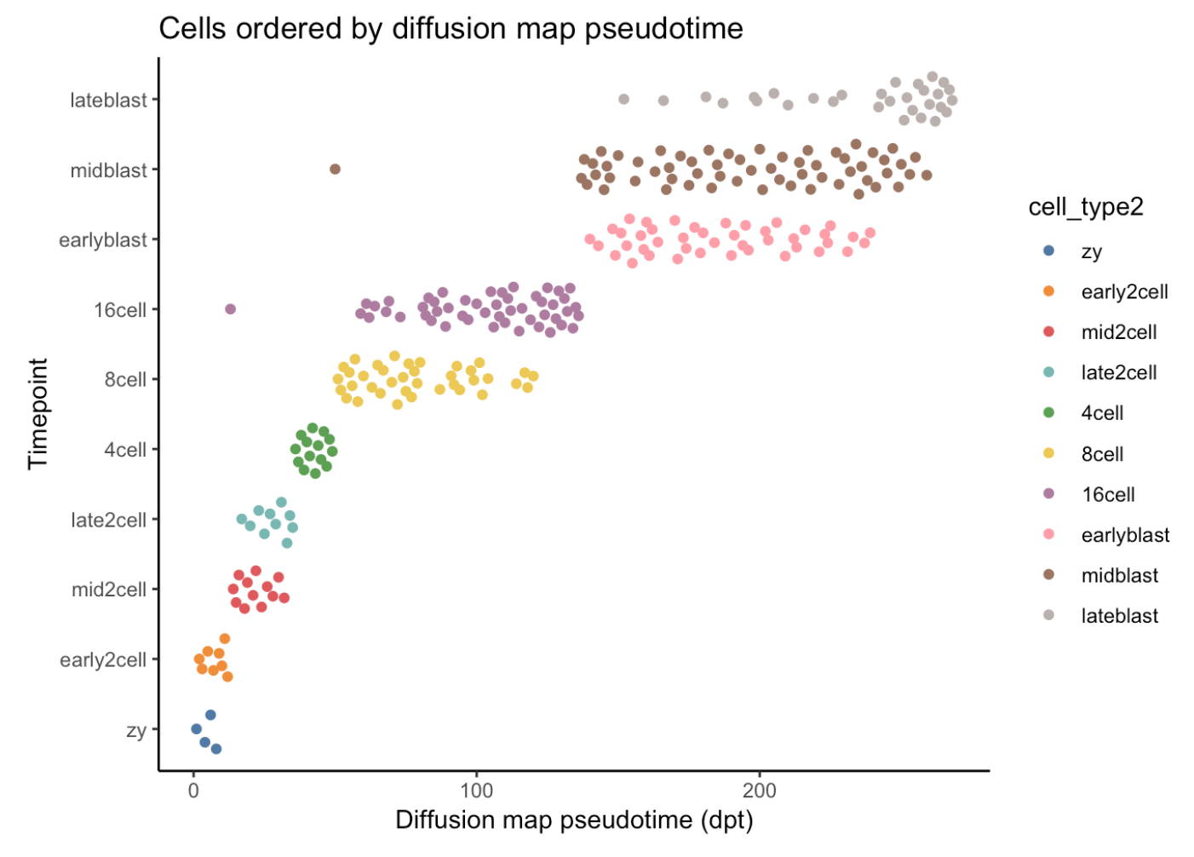
Workflow
Batch correction
QC
SC experiment
DE
Enrichment analysis
Clustering
Dimensionality reduction
Visualization
Pseudotime

Slide 4
Quality control
QC is essential for proper visualization, clustering and functional analysis
Based primarily on:
Library size, counts per gene and number of unique genes (features)
% mitochondrial and ribosomal counts
Cell-cycle scoring
Data is then normalized and scaled
Spike-ins can be used to help normalization and scaling (ERCC)

Slide 5
Quality control
Possible doublets!
Nº of genes and counts per gene
Overall depth of the sequencing

Slide 6
Quality control
% mitochondrial counts
Dying cells
% ribosomal counts and genes
Noise!
Possible dying cells!

Slide 7
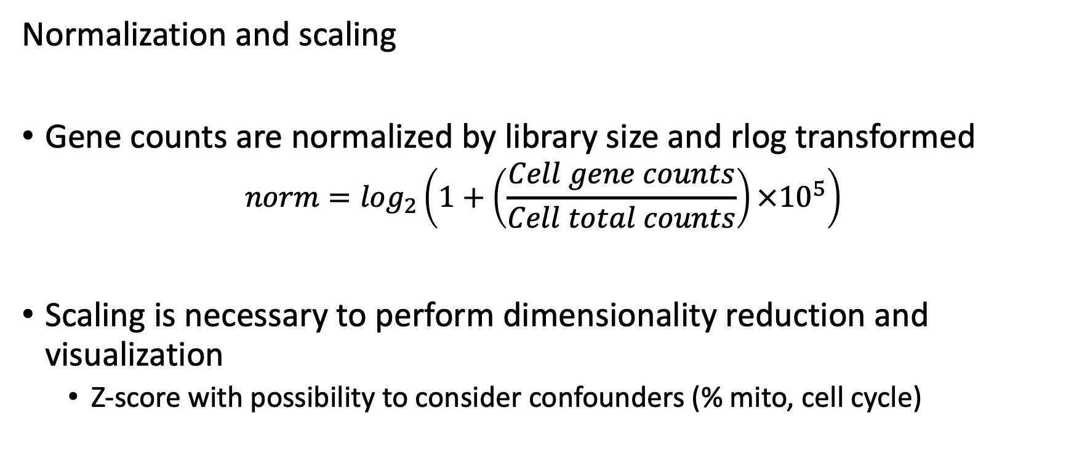
Quality control
Normalization and scaling
Gene counts are normalized by library size and rlog transformed
$$norm=\log_{2}\left(1+\left(\frac{Cell gene counts}{Cell total counts}\right){×10}^{5}\right)$$
Scaling is necessary to perform dimensionality reduction and visualization
Z-score with possibility to consider confounders (% mito, cell cycle)

